Slide 1

Data types and Comments

Slide 2
Outline
Data types and Memory allocation
Types of variables and Scopes of Variables
Naming Conventions
Interview Questions

Slide 3
Data Types and Memory Allocation
Java is a strongly typed language. This means that every variable must have a declared type. There are eight primitive types in Java.
Four integer types
  byte, short, int, long
Two ﬂoating-point number types
  float (6-7 decimal digits)
  double(15 decimal digits)
one character type
one a boolean type

Slide 4
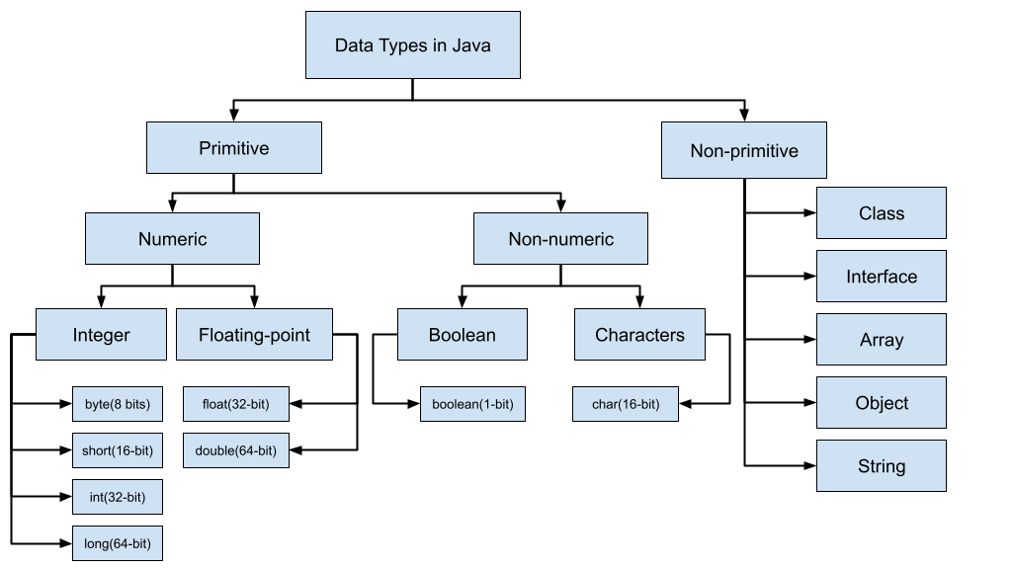

Slide 5
Rules of Identifiers
Identifiers in Java are names that identify elements such as classes, variables, and methods in a program. In other words, an identifier is one that is for naming variables, user-defined methods, classes, objects, parameters, labels, packages, and interfaces in a program.
Java identifier is a sequence of characters that consists of letters, digits, underscores (_), and dollar signs ($).
It must start with a letter, an underscore (_), or a dollar sign ($). It cannot begin with a digit.
It cannot be a reserved word.
It cannot be true, false, or null.
It cannot contain !@#$%^&*()_+-=\|/.,<>?”:;’ signs.
It can be of any length.
Oracle Documentation
Note: Using $ sign for variable naming is not recommended by oracle.

Slide 6
Comment types
Single line comment
Multi line comment
Java documentation comment

Slide 7
Types of variables
Scopes of Variables
Types of variables and Scopes of Variables
Local variables
Instance variables
Class/Static variables
Method Level Scope
Object Level Scope
Class Level Scope

Slide 8
Naming conventions
Naming Conventions
Packages
Classes
Interfaces
Methods
Variables
Constants
Programming Case Types
camelCase
PascalCase
snake_case
kebab-case
MACRO_CASE
Train-Case
Oracle Documentation

Slide 9
Interview Questions

Slide 10
The only thing standing between you and outrageous success is continuous progress.

